Slide 1
CHAPTER 1
APPLICATIONS OF INTEGRATION

Slide 2
CONTENTS
1.1. More about Areas
1.2. Volumes
1.3. Arc Length
1.4. Average Value of a Function
1.5. Applications to Physics & Engineering
1.6. Applications to Economics & Biology

Slide 3
1.5. Applications to Physics & Engineering
1.5.1. Work
1.5.2. Hydrostatic Pressure & Force
1.5.3. Moments & Center of Mass

Slide 4
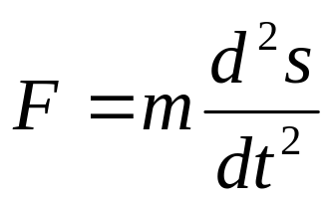
1.5.1. Work
Recall that if an object moves along a straight line with position function s(t), then the force F acting on the object is given by Newton's Second Law of Motion
If the mass m is measured in kg, the displacement in meter, the time in seconds, then the force is measured in newton (1N=1kg⋅m/s²).
In the US, pound (weight) is the Customary unit of force

Slide 5
If the acceleration is constant, the force is also constant and the work done is defined by
W = Fd
If F is measured in newton and d in meter, then W is measured in joule (1J=1N-meter). In the US, the unit for W is foot-pound (1ft-lb ≈ 1.36 J)
Example. If a 1.2kg book is lift off the ground to be put on a desk of 0.7m high. Then the force exerted is
F = mg = (1.2)(9.8) = 11.76 N
The work done is
W = Fd = (11.76)(0.7) ≈ 8.2 J
If a 20 lb is lift 6 ft off the ground, then the force is F=20 lb-weight and the work done is
W = Fd = 20 ⋅ 6 =120 ft-lb

Slide 6
How the work is defined if the force is not constant ?
Suppose that the object moves along the x-axis in the positive direction from x=a to x=b, and the force f(x) acts on the object at the point x is a continuous function.
We divide [a, b] into n subintervals of equal width Δx by the end points x₀, x₁,…, x_{n}
and choose sample point x_{i}* in the i^{th} subinterval.
x₁* x₂* . . . x_{i}* . . . x_{n}*
a=x₀ x₁ x₂ . . . x_{i-1} x_{i} . . . x_{n-1} b= x_{n}

Slide 7
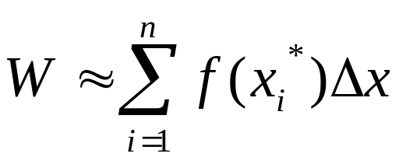
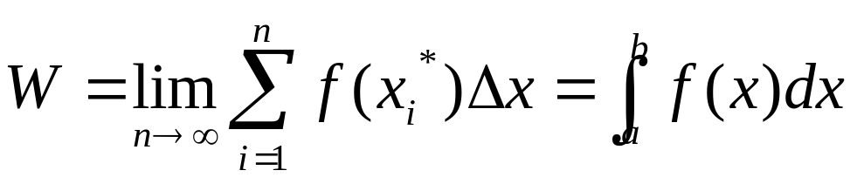
If n is large, we can assume the force is constant and equal to f(x_{i}*) in [x_{i-1}, x_{i}].
Then the total work is approximated by
Letting n→∞ we can defined the work done in moving the object from a to b by

Slide 8
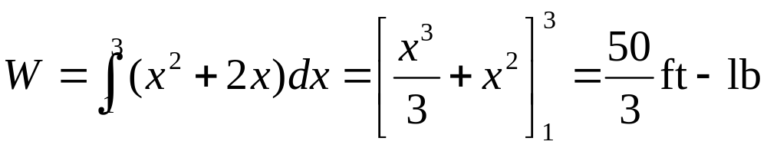
Example. When a particle is located at x ft from 0, a force of x² + 2x lbs acts on it. How much work done in moving it from x = 1 to x = 3?
Solution. The work done is
Hooke's Law: the force required to maintain a spring stretched x units beyond its natural length is
f(x) = kx
where k is the spring constant and x is not too large

Slide 9
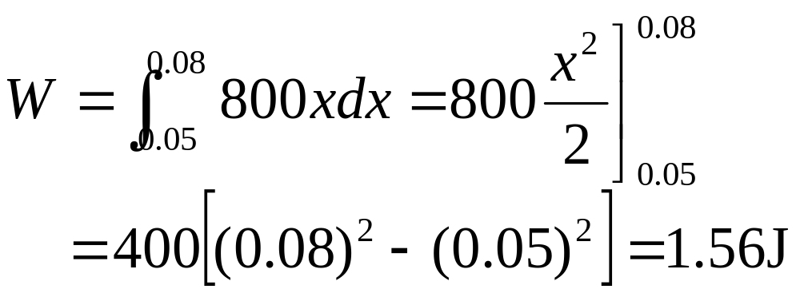
Example. A force of 40N is required to maintain a spring stretched from its natural length of 10cm to 15cm. How much work is done to stretch the spring from 15cm to 18cm
Solution. Hooke's Law gives
40 = f(0.05) = 0.05k
Hence k = 800
Thus the work done in stretching the spring from 15cm to 18cm is

Slide 10
1.5.2. Hydrostatic Pressure & Force
A thin horizontal plate with area A (m²) is submerged in a fluid of density ρ (kg/m³) at a depth d(m) below the surface of the fluid.
The volume of the fluid directly above the plate is V=Ad, and mass m=ρ V=ρ Ad.
The force exerted by the fluid on the plate is
F = mg =ρ gAd
Where g is the acceleration due to the gravity.
d
A

Slide 11
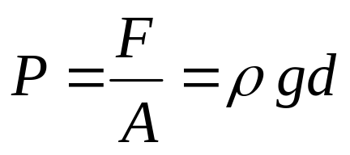
1.5.2. Hydrostatic Pressure & Force
The force exerted by the fluid on the plate is
F=mg=ρgAd
The pressure P (pascals) on the plate is defined by
d
A

Slide 12
Example. Find the pressure at the bottom of a swimming pool 2m deep
Solution. Since the density of the water is ρ=1000kg/m³, the pressure at the bottom is
P=ρgd=1000×9.8 × 2=19,600 Pa=19.6 kPa
Note. At any point in the liquid, the pressure is the same in all directions.

Slide 13
Example. A dam has the shape of a trapezoid. The height is 20m, the width is 50m at the top and 30m at the bottom. Find the force on the dam due to the hydrostatic pressure if the water level is 4m from the top of the dam
Solution. We choose the vertical x-axis with the origin at the surface of the water and directed downward. So the depth is at 16m.
We divide [0, 16] into n subintervals of equal length with endpoints x_{i}, and choose x_{i}*∈[x_{i-1}, x_{i}].
10m
50m
a
x_{i}
20m
30m

Slide 14
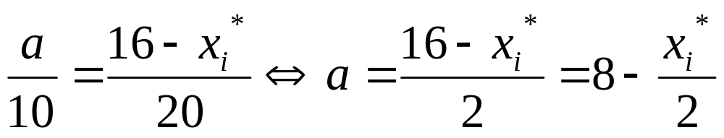
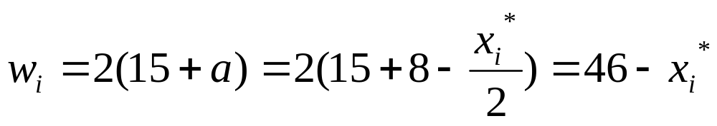
We have
Therefore the width of the i^{th} strip is
The area of the i^{th} strip is approximately
A_{i} ≈ w_{i} Δx = (46 – x_{i}*) Δx
If Δx is small the pressure on the i^{th} strip is constant and approximately
P_{i} ≈ 1000gx_{i}*
10m
50m
a
x_{i}*
20m
30m

Slide 15
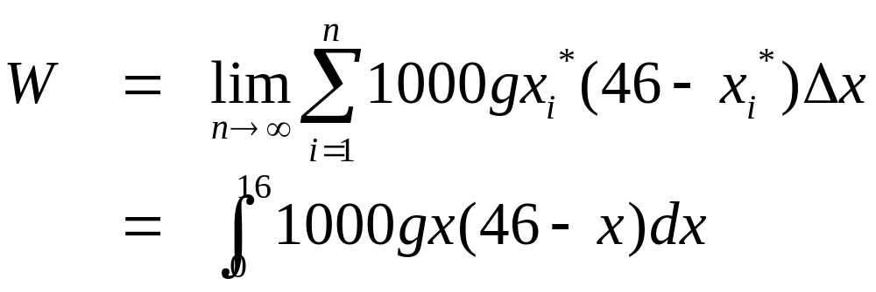
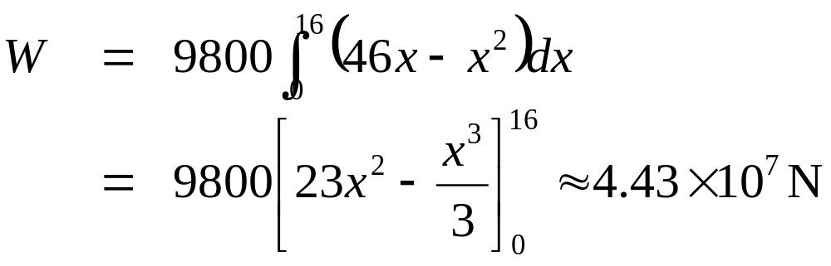
A_{i} ≈ w_{i} Δx = (46 – x_{i}*) Δx
P_{i} ≈ 1000gx_{i}*
The hydrostatic force acting on the i^{th} strip is
F_{i} = P_{i} A_{i} ≈ 1000g x_{i}*(46 – x_{i}*) Δx
The total hydrostatic force acting on the dam is

Slide 16
1.5.3. Moments & Center of Mass
We want to find a point P called the center of mass (or center of gravity) on which a thin horizontal plate of any given shape can be balanced
We first consider 2 masses m₁ and m₂ attached to a rod of negligible mass on opposite sides of a fulcrum.
According to the Law of Lever, the rod will balance if
m₁ d₁ = m₂ d₂
d₁
d₂
m₁
m₂

Slide 17

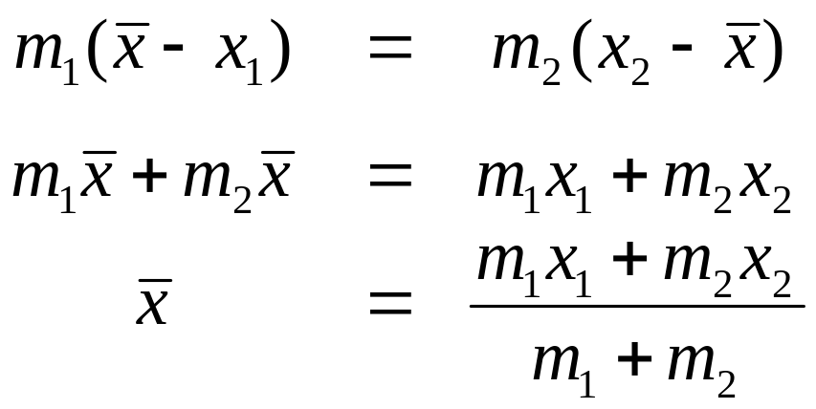
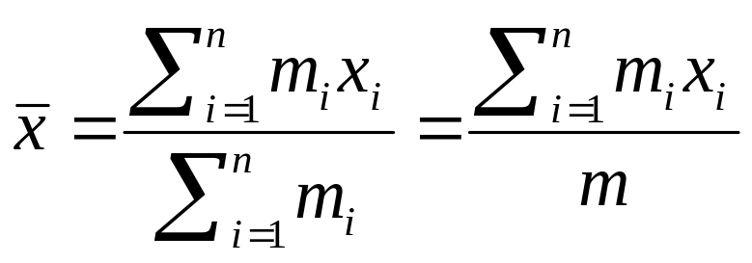
Suppose the x-coordinates of m₁, m₂ and the center of mass are x₁, x₂ and respectively, then we have
The numbers m₁x₁ and m₂x₂ are called the moments of the masses m₁ and m₂
In general if we have n masses m₁, m₂, …, m_{n} located at the points x₁, x₂, …, x_{n} on the x-axis, then the center of mass of the system is

Slide 18
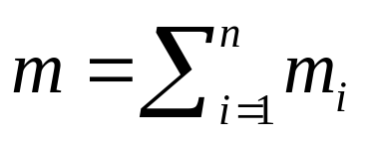
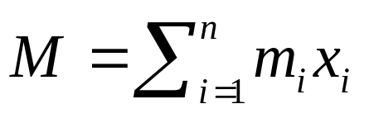

(*)
is the total mass of the system and
is the moment of the system with respect to the origin
The equation (*) becomes
Therefore the moment of the system would be as if the total mass is concentrated at the center of mass

Slide 19
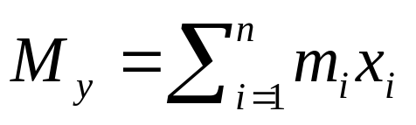
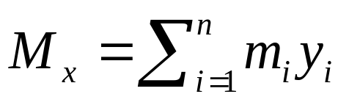
Now we consider a system of n particles with masses m₁, m₂, …, m_{n} located at the points
(x₁, y₁), (x₂, y₂), …, (x_{n}, y_{n}) in the xy-plane,
then the moment of the system about the y-axis is defined by
and the moment of the system about the x-axis is
(x₁, y₁)
(x_{n}, y_{n})
(x₂, y₂)

Slide 20
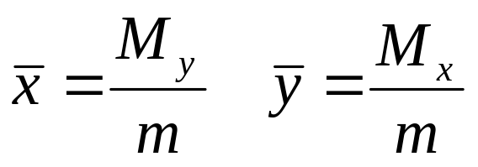
The moment of the system about the two axis are
is the total mass of the system
and the coordinates of the center of mass are given by
(x₁, y₁)
(x_{n}, y_{n})
(x₂, y₂)

Slide 21
Now we consider a flat plate (a lamina) with uniform density ρ that occupies a region R in the plane.
We want to locate the center of mass of the plate called the centroid of R.
Note. If R is symmetric with respect to a line l then the center of mass lies on l.
In particular, the centroid of a rectangle is its center.
On the other hand if R = R₁∪R₂, R₁∩R₂=∅, then the moment of R is the sum of moments of R₁andR₂

Slide 22
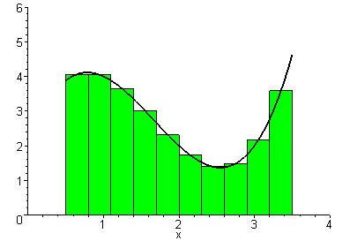
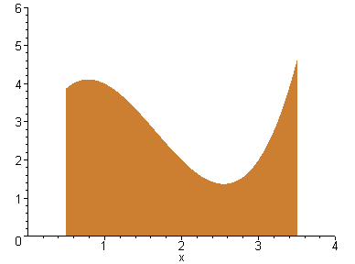
Let R be the region under the curve y=f(x) from x=a to x=b, where f is a continuous function.
We divide [a, b] into n subintervals of equal width Δx with the endpoint x₀, x₁,…, x_{i},…, x_{n}.
We select the midpoint of [x_{i-1}, x_{i}] as the sample point x_{i}*
R is approximated by the rectangles R_{i} with base [x_{i-1}, x_{i}] and height f (x_{i}*).
The centroid and the mass of R_{i} are
x₀ x₁ x₂ . . . x_{i-1} x_{i} . . . x_{n-1} x_{n}

Slide 23
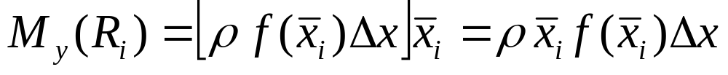
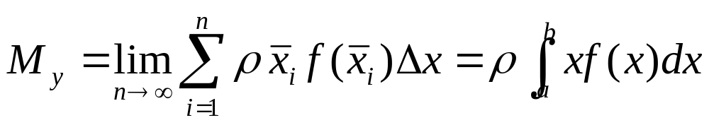
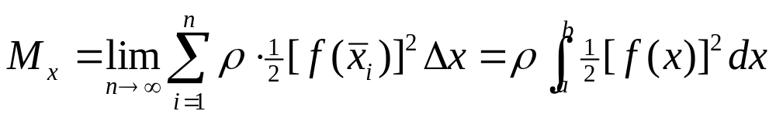
The moment of R_{i} about the y-axis is
Therefore the moment of R about the y-axis is
Similarly the moment of R_{i} about the x-axis is
Therefore the moment of R about the x-axis is

Slide 24
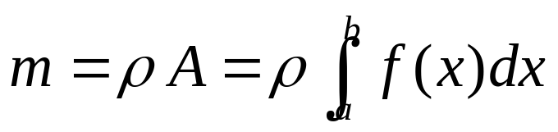
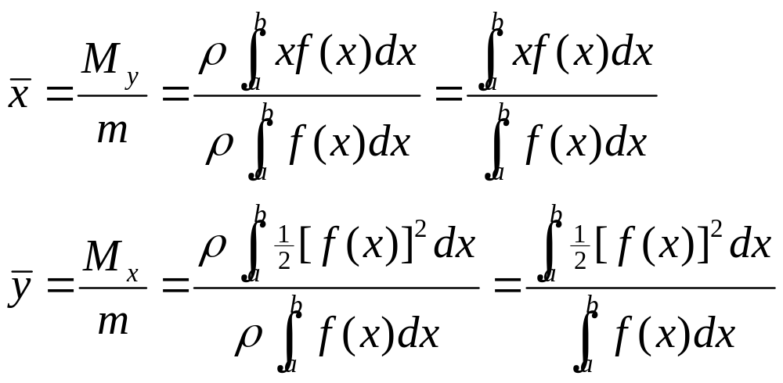
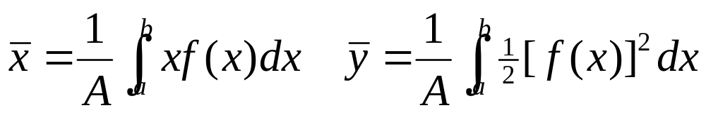
The mass of the plate is the product of its density ρ and its area A
Hence the coordinates of the center of mass are

Slide 25
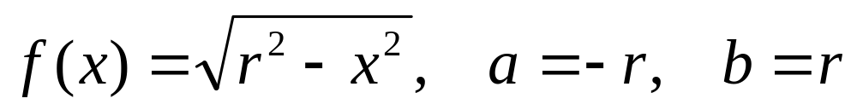

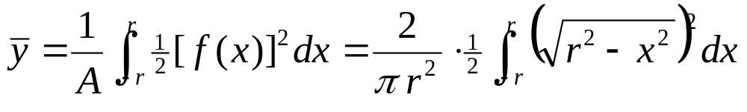
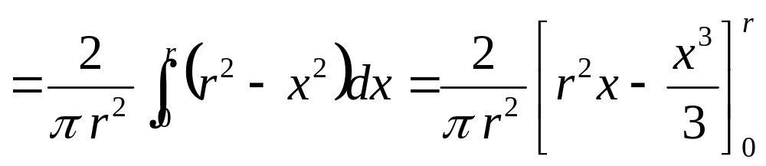
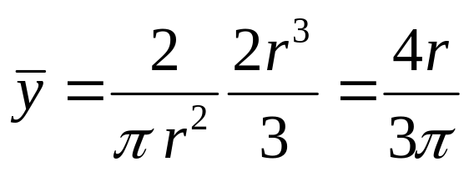
Example. Find the center of mass of a semicircular plate of radius r
Solution. The equation of the semicircle is
By symmetry, the center of mass must lie on 0y, so

